Slide 1


DETECTION
Introduction
Data Cleaning
EDA
Models
Tools
Conclusion
Classification Problem
INTROUSION

Slide 2
Bootcamp Data Science Project
Raghad Abdullah Alrehaili
Introductio
Data Cleaning
EDA
Models
Tools
Conclusion
Classification Problem

Slide 3



Introduction
Data Cleaning
EDA
Models
Tools
Conclusion
Classification Problem
PRESENTATION CONTENT
Data Cleaning
Models
Introduction
EDA & Preprocessing
Conclusion

Slide 4

INTRODUCTION
Introduction
Data Cleaning
EDA
Models
Tools
Conclusion
Classification Problem
The dataset is a large dataset contains 80 columns , and 1048575 rows, created in 2018 by New Brunswick's University, based on the logs of the University server that aims to analyzing DDoS data. And it is separated into different files dependent on the date. Each file is unbalanced, and I will deal with this problem.

Slide 5
1
3
2
4
Introduction
Data Cleaning
EDA
Models
Tools
Conclusion
Classification Problem
DATA Cleaning
Check for duplicated values and drop them
Select only most important features
Drop the columns that contain null values
Detect correlations between features and delete the columns that have correlation higher than 0.69

Slide 6
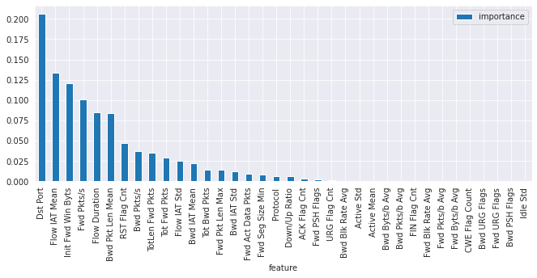
Introduction
Data Cleaning
EDA
Models
Tools
Conclusion
Classification Problem
DATA Cleaning

Slide 7
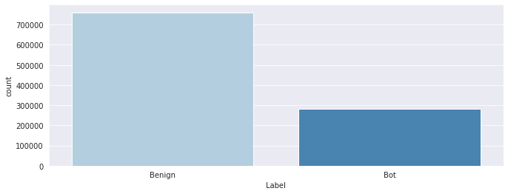
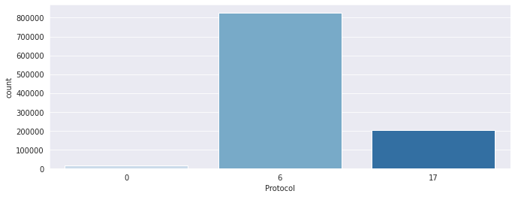
Introduction
Data Cleaning
EDA
Models
Tools
Conclusion
Classification Problem
EDA
Q1: How many data samples represent a threat?
Q2: Which protocol most of malicious packets came from?

Slide 8
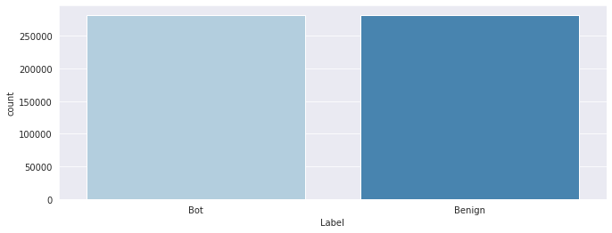
Introduction
Data Cleaning
EDA
Models
Tools
Conclusion
Classification Problem
Preprocessing

Slide 9
Models
Introduction
Data Cleaning
EDA
Models
Tools
Conclusion
Classification Problem
Accuracy: 97%
Precision: 100%
Recall: 94%
F1 score: 97%
Logistic Regression
Accuracy: 100%
Precision: 100%
Recall: 100%
F1 score: 100%
Accuracy: 100%
Precision: 100%
Recall: 100%
F1 score: 100%
Random Forest
k-nearest Neighbors

Slide 10
Tools used
Introduction
Data Cleaning
EDA
Models
Tools
Conclusion
Classification Problem
Seaborn
Scikit-learn
Pandas & NumPy
Matplotlib

Slide 11
Conclusion
Introduction
Data Cleaning
EDA
Models
Tools
Conclusion
Classification Problem
In conclusion, adapted classification models results satisfies the main goal of this project , in terms of high ability to learn the data pattern thus the precise prediction process.
In future, further steps to manipulate data will be taken , beside trying to use another classifier as ANN
(artificial neural network)

Slide 12
THANK YOU!
Introduction
Data Cleaning
EDA
Models
Tools
Conclusion
Classification Problem
Do you have any questions?

